Slide 1

Management Group and Subscription Organization
<name>
Notes:
Hello, my name is …, and I’m a “CE/CSA” working on Azure in our Customer Success organization.
This is a 200/300 level presentation meant to give you enough information where you can make informed decisions, and understand how these components work.
Feel free to ask questions as we go.
So, with that, let’s dive in.

Slide 2
Agenda
Management Groups
Management Group Hierarchy
Subscriptions
Subscription Organization and Governance
Subscription Quota and Capacity
Enterprise Scale Landing Zone
Session Summary
Next Steps
Identity
Notes:
This is the agenda for Management Group and Subscription Organization in Azure. We will cover all of these items at a high level, and when we are done you should have a better understanding of how to manage and assign access to your Azure environment.

Slide 3
Management Groups
Management Group Hierarchy
Subscriptions
Subscription Organization and Governance
Subscription Quota and Capacity
Enterprise Scale Landing Zone
Session Summary
Next Steps

Slide 4
Azure landing zone conceptual architecture
The Azure landing zone conceptual architecture represents the strategic design path and target technical state for your Azure environment.
It will continue to evolve in lockstep with the Azure platform and is ultimately defined by design decisions aligned with defined principles to safeguard your Azure journey.
Notes:
Enterprise-scale is an architecture approach and reference implementation that enables effective construction and operationalization of landing zones on Azure, at scale and aligned with Azure Roadmap and Microsoft Cloud Adoption Framework for Azure.
In this design workshop we review each design guidelines and what decisions need to be documented for the of the Azure Enterprise-scale landing zone implementation.

Slide 5
















Azure Landing Zones
Azure Policy
Azure AD (RBAC)
Azure ARM Templates
Azure Tags
Azure Resource Graph
Azure Audit
Azure Automation
Azure Security Center
Azure Monitor
Azure Log Analytics
Azure Defender
Azure Sentinel
Azure Key Vault
Azure Automanage
Resource Inventory
Billing
Monitoring & Logs
Secrets Management
Governance
Compliance & Security
SAP
Identity
Internal
(AVD, corporate apps, etc.)
Management
LZ / Platform
External
(web presence, external customer apps, etc.)
Connectivity
Landing Zones
Platform Management
Notes:
When we talk about building out your Azure environment, we want to take a similar approach by separating platform management from workload (landing zone) management

Slide 6
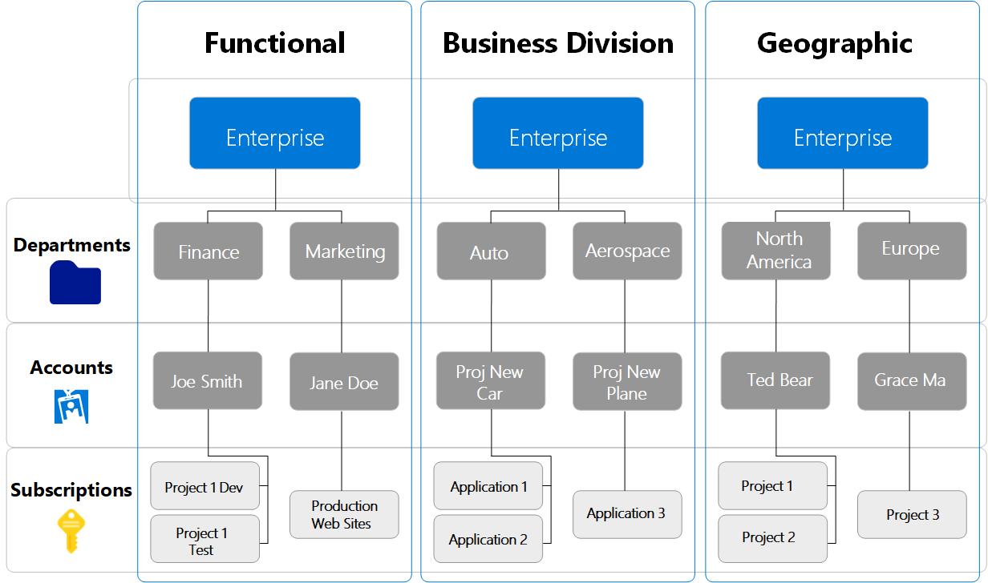
Enterprise Agreement
Represents the commercial agreement between you and Microsoft
Departments segment the enrollment into logical groupings
Accounts are organizational units in the EA Portal
Account Owners are allowed to provision new Subscriptions in the EA

Slide 7
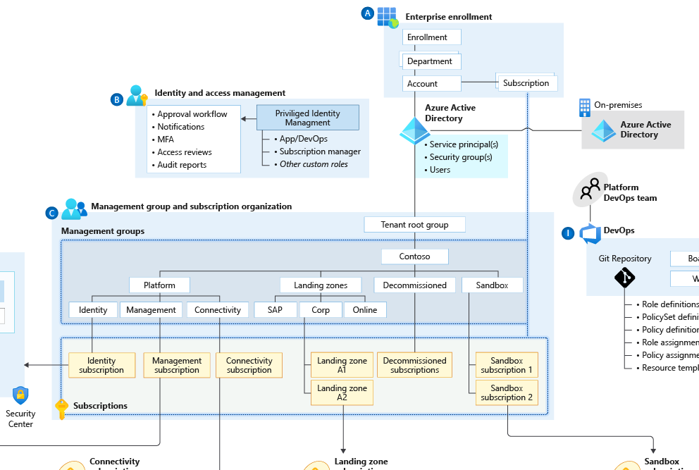
Microsoft Enrolment and Azure AD Tenants
Enterprise enrollment roles links users with their functional role and consists of
Enterprise Administrator
Department Administrator
Account Owner
Service Administrator
Notification Contact
Notes:
If they don’t have separate identity then from the platform perspective – it is just production in test.
Examples:
Department isn’t Org chart. Create Departments only if business domains have independent IT capabilities and map customer business divisions.
If multiple AAD tenants are used, ensure the Account owner is associated with the same tenant as where subscriptions from the EA account are provisioned. Separate Dev/Test/Prod environments at an EA account level to support holistic isolation.
Do not move or rename an EA Account in AD/Azure AD
Do not ignore notification emails sent to the notification account email address. Microsoft sends important EA wide communications to this account. Setup the notification account email address to ensure notifications are sent to an appropriate group mailbox.
Assign a budget for each account and establish an alert associated with the budget.
Restrict and minimise the number of Account owners within the Enrolment to avoid the proliferation of admin access to Subscriptions and associated Azure resources

Slide 8
Management Groups
Management Group Hierarchy
Subscriptions
Subscription Organization and Governance
Subscription Quota and Capacity
Enterprise Scale Landing Zone
Session Summary
Next Steps

Slide 9
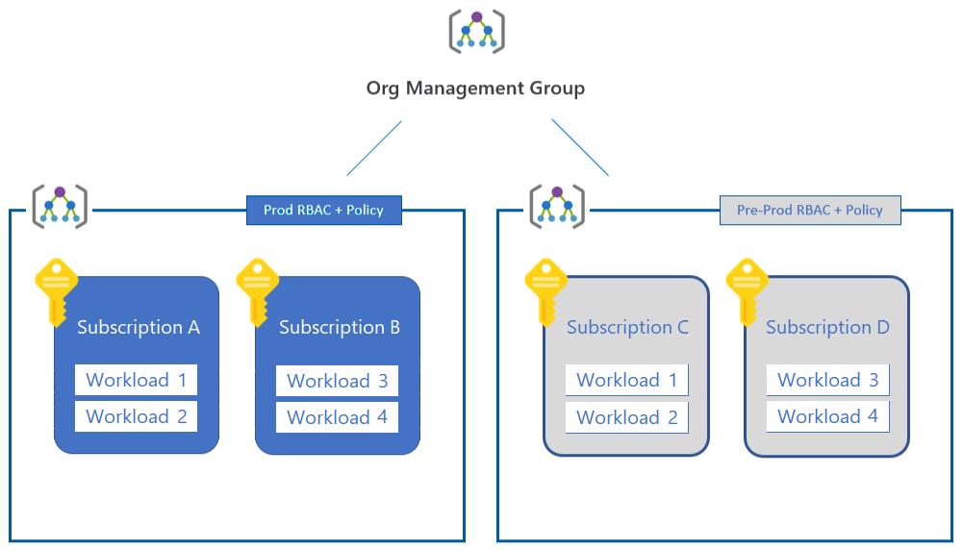
Subscriptions
Unit of management, billing and scale within Azure
Boundary for Policy, governance and isolation
Houses resource groups and Azure resources
Resource providers determine which Azure services are available

Slide 10
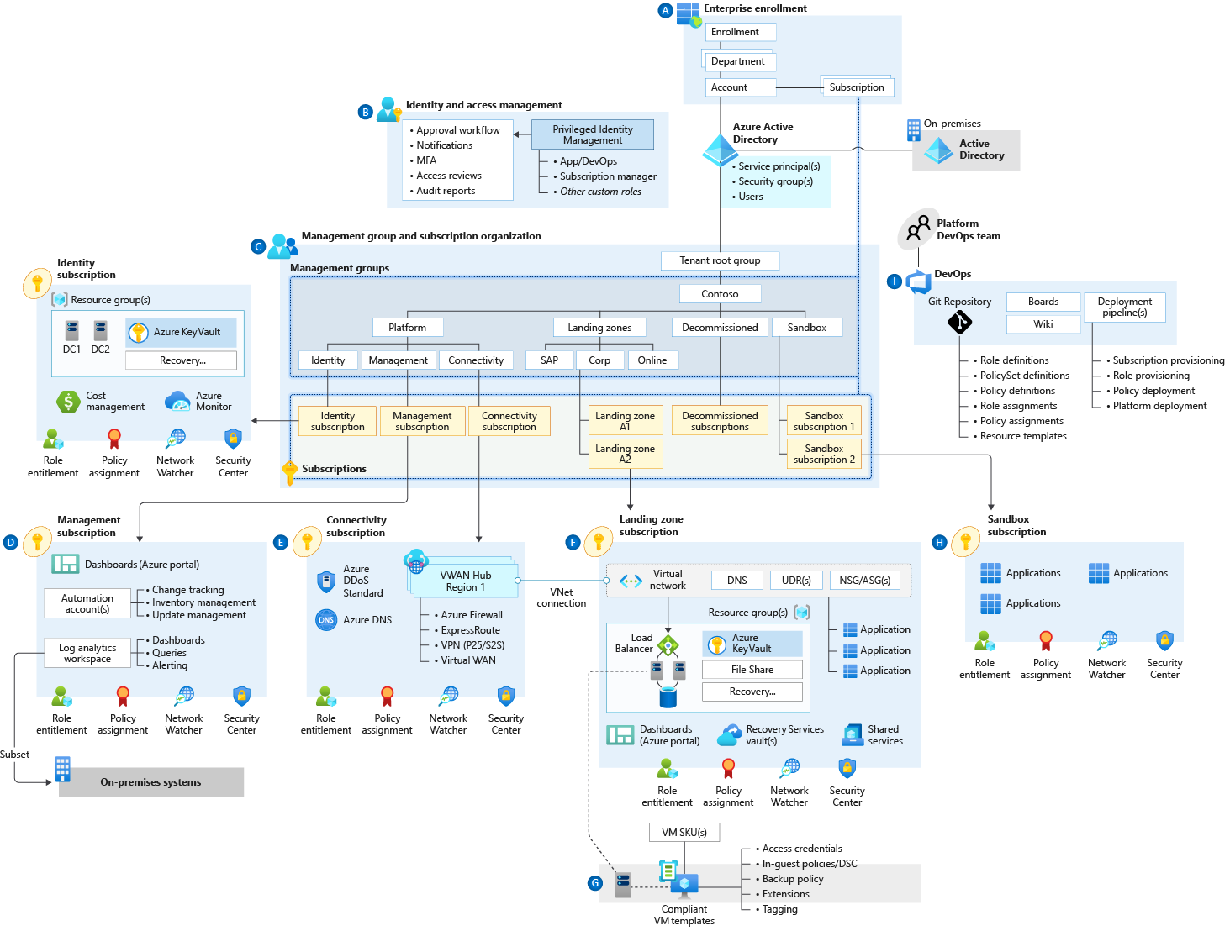
Subscription Design Considerations
Subscriptions serve as a unit of scale
Platform specific subscriptions
Identity
Connectivity
Management
Landing Zone
Sandbox
Subscriptions should be used as a management boundary for governance and isolation

Slide 11
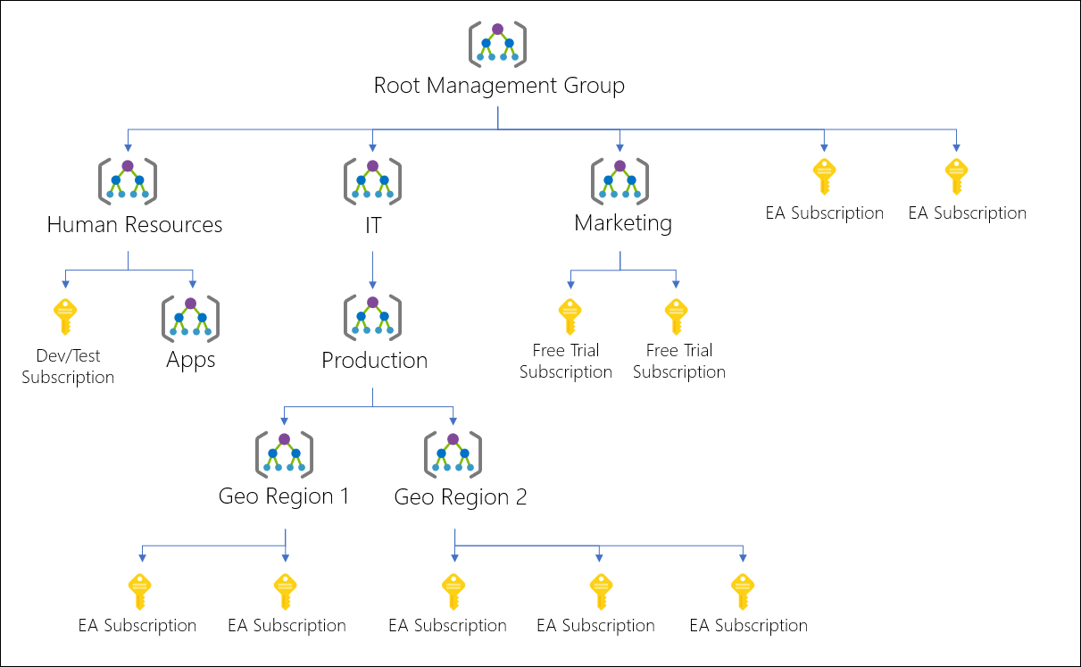
Why use management groups?
Higher scope than Subscriptions
Effectively group and organize subscriptions
Apply policies and IAM across multiple subscriptions
View costs for all subscriptions and resources under a management group
Notes:
Management groups are a way to group subscriptions to simplify management of your Azure environment.
One of the biggest benefits of management groups is the ability to scope Azure Policy and RBAC to the management group and have that policy and Azure IAM assignment trickle down to all subscriptions moved into the management group hierarchy. Using management groups in this way allows you to treat subscriptions as units of scale, and management groups as a way to organize resources based on a variety of criteria.

Slide 12

Management Group Limits
10,000 Management groups can exist in a single directory
A management group tree supports six levels of depth
A subscription and management group can only be associated with one parent
A single management group can support multiple child subscriptions and management groups

Slide 13
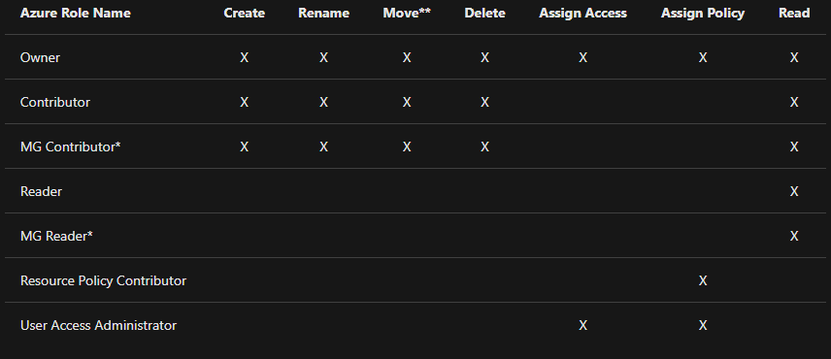
Management group access

Slide 14
Management Groups
Management Group Hierarchy
Subscriptions
Subscription Organization and Governance
Subscription Quota and Capacity
Enterprise Scale Landing Zone
Session Summary
Next Steps

Slide 15
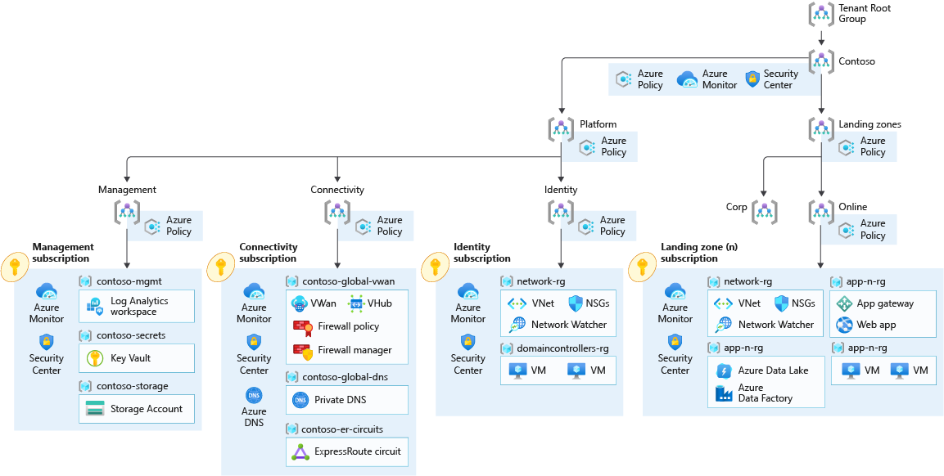
Enterprise Scale Management Group Hierarchy
Notes:
The main idea behind enterprise scale is to separate “landing zones” (application workloads) from “platform” (internal management of Azure) into a separate structure.
This approach has many benefits including a simplified RBAC model and an easy way to view platform cost vs workload cost.

Slide 16
Hierarchy Design Recommendations
Avoid organizing for billing purposes
Keep the management group hierarchy flat (3-4 levels)
Focus on organizing based upon Azure Policy Assignments (restrict public IP on internal workloads, prod/non-prod naming conventions, etc.)
Utilize a sandbox management group
Limit Policy assignments made at the root management group
Configure a default management group for new subscriptions
Create management groups to represent regulatory workloads (GDPR, region-locked, etc.)
Notes:
Keep the management group hierarchy reasonably flat, with no more than three to four levels ideally. This restriction reduces management overhead and complexity.
Avoid duplicating your organizational structure into a deeply nested management group hierarchy. Management groups should be used for policy assignment versus billing purposes. This approach necessitates using management groups for their intended purpose in enterprise-scale architecture, which is providing Azure policies for workloads that require the same type of security and compliance under the same management group level.
Create management groups under your root-level management group to represent the types of workloads (archetypes) that you'll host and ones based on their security, compliance, connectivity, and feature needs. This grouping structure allows you to have a set of Azure policies applied at the management group level for all workloads that require the same security, compliance, connectivity, and feature settings.
Use resource tags, which can be enforced or appended through Azure Policy, to query and horizontally navigate across the management group hierarchy. Then you can group resources for search needs without having to use a complex management group hierarchy.
Create a top-level sandbox management group to allow users to immediately experiment with Azure. Users can then experiment with resources that might not yet be allowed in production environments. The sandbox provides isolation from your development, test, and production environments.
Use a dedicated service principal name (SPN) to execute management group management operations, subscription management operations, and role assignment. Using an SPN reduces the number of users who have elevated rights and follows least-privilege guidelines.
Assign the User Access Administrator role at the root management group scope (/) to grant the SPN just mentioned access at the root level. After the SPN is granted permissions, the User Access Administrator role can be safely removed. In this way, only the SPN is part of the User Access Administrator role.
Assign the Contributor role to the SPN previously mentioned at the root management group scope (/), which allows tenant-level operations. This permission level ensures that the SPN can be used to deploy and manage resources to any subscription within your organization.
Create a Platform management group under the root management group to support common platform policy and Azure role assignment. This grouping structure ensures that different policies can be applied to the subscriptions used for your Azure foundation. It also ensures that the billing for common resources is centralized in one set of foundational subscriptions.
Limit the number of Azure Policy assignments made at the root management group scope (/). This limitation minimizes debugging inherited policies in lower-level management groups.
Use the policies available for enterprise-scale landing zones to enforce compliance requirements either at management group or subscription scope. Refer to guidance in the Policy-driven governance section to learn more about the governance requirements that can be addressed.
Ensure that only privileged users can operate management groups in the tenant by enabling Azure RBAC authorization in the management group hierarchy settings (by default, all users are authorized to create their own management groups under the root management group).
Configure a default, dedicated management group for new subscriptions to ensure that no subscriptions are placed under the root management group. This is especially important if there are users eligible for MSDN or Visual Studio benefits and subscriptions. A good candidate for this type of management group is a Sandbox management group.

Slide 17
Management Groups
Management Group Hierarchy
Subscriptions
Subscription Organization and Governance
Subscription Quota and Capacity
Enterprise Scale Landing Zone
Session Summary
Next Steps

Slide 18
Management Groups
Management Group Hierarchy
Subscriptions
Subscription Organization and Governance
Subscription Quota and Capacity
Enterprise Scale Landing Zone
Session Summary
Next Steps

Slide 19
Quota and Capacity
Each Azure region contains a finite number of resources
Consider limits and quotas within the Azure platform for each service that your workloads require
Consider limits and quotas within the Azure platform for each service that your workloads require
Notes:
Azure subscription limits and quotas - Azure Resource Manager | Microsoft Docs

Slide 20
Management Groups
Management Group Hierarchy
Subscriptions
Subscription Organization and Governance
Subscription Quota and Capacity
Enterprise Scale Landing Zone
Session Summary
Next Steps

Slide 21
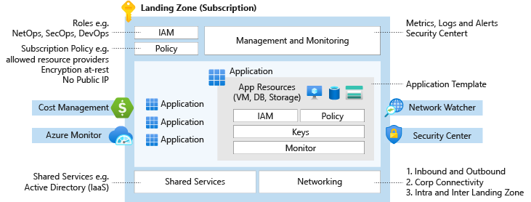
Enterprise Scale Landing Zones
A landing zone is an environment for hosting your workloads
Azure landing zones enable application
migration
modernization
Innovation
Landing zones consider all platform resources required to support the application portfolio
Scalable and Modular
Notes:
A landing zone is an environment for hosting your workloads, preprovisioned through code. Watch the following video to learn more.
Scalable: All Azure landing zones support cloud adoption at scale by providing repeatable environments, with consistent configuration and controls, regardless of the workloads or Azure resources deployed to each landing zone instance.
Modular: All Azure landing zones provide a modular approach to building out your environment, based on a common set of design areas. Each design area can be easily extended to support the distinct needs of various technology platforms like Azure SQL Database, Azure Kubernetes Service, and Azure Virtual Desktop.

Slide 22
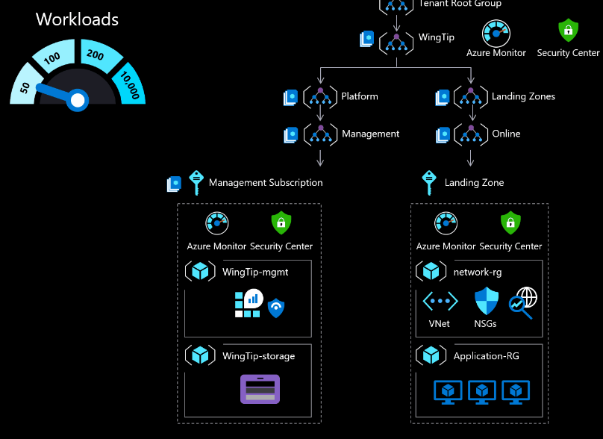
ESLZ for 50 Workloads

Slide 23
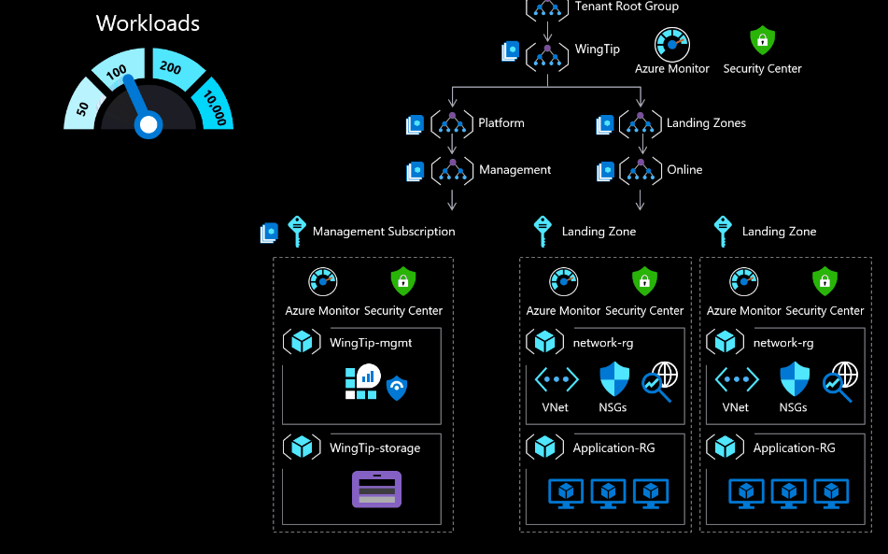
ESLZ for 100 Workloads

Slide 24
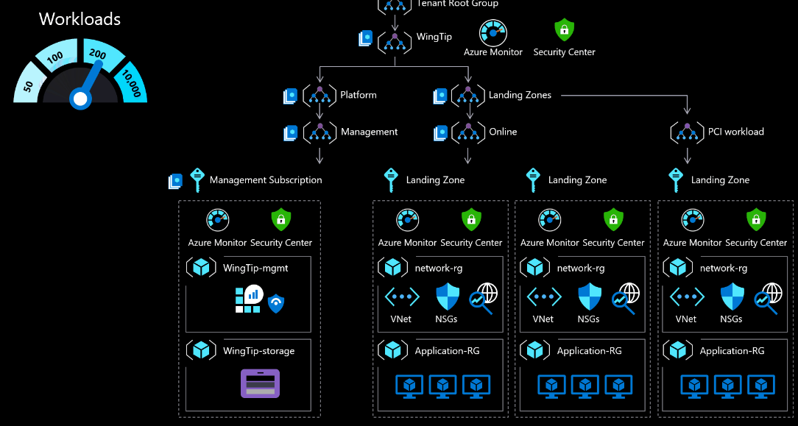
ESLZ for 200 Workloads

Slide 25
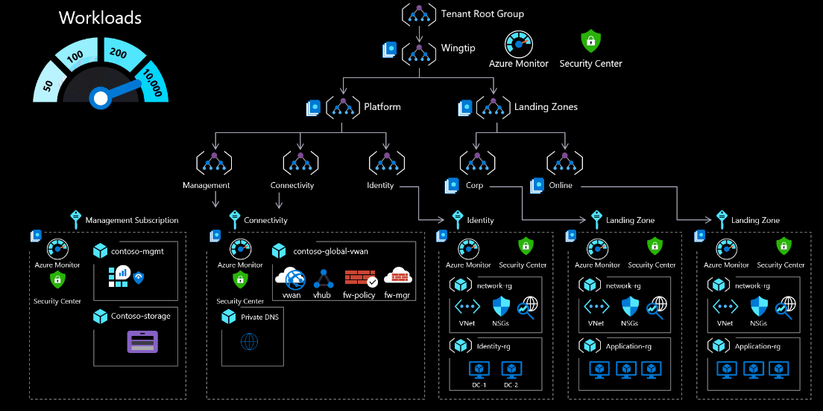
ESLZ for 10000 Workloads

Slide 26
Summary
Treat subscriptions as a democratized unit of management aligned with business needs and priorities.
Keep the management group hierarchy reasonably flat, with no more than three to four levels ideally
Consider limits and quotas within the Azure platform for each service that your workloads require.
Use reserved instances to prioritize reserved capacity in required regions.
Use Azure Cost Management + Billing to aggregate costs. Make it available to application owners.

Slide 27
Thank you!

